Slide 1

Global Development Measurement
Team Name: Group 5
Mentor : Ms. Snehal Shinde
Date: 22/May/2023
Group Members :
Mr. Sumedh Ramesh Dhawale
Mr. Nishchay Sridhar Jadhav
RENATI ROHITH KUMAR REDDY
Mr. DIBYANSHU
Mr. Prajwal Prabhakar Kamble
Mr. Vishwanath B. Hiremath

Slide 2
Business Problem:
Creating Clusters on Global Development Measurement dataset
Objective:
1. Perform EDA on given dataset
2. Build Model on processed data
3. Evaluate Model
4. Feedback and Deployment

Slide 3
Project Architecture / Project Flow
Exploratory Data Analysis (EDA)
Model Building
Model Evaluation
Model Deployment
Feature Engineering

Slide 4
Exploratory Data Analysis (EDA) and
Feature Engineering

Slide 5
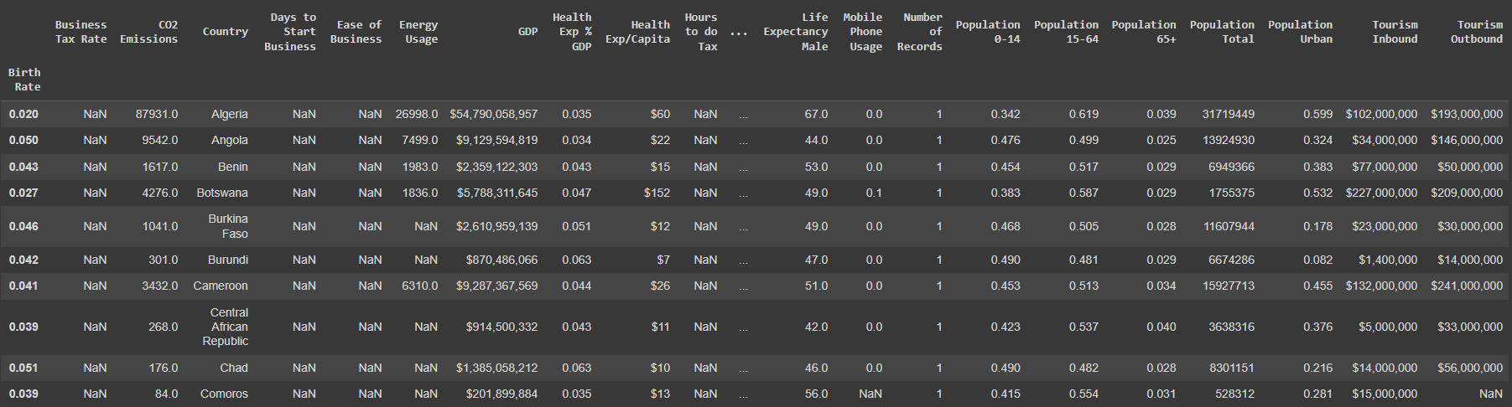
Data set details
No. of Rows: 2704
No. of Columns: 24
No. of Objects: 6 (Business Tax Rate, Country, GDP, Health Exp/Capita, Tourism Inbound, Tourism Outbound)
No Duplicate Columns
Dropped Columns: “Ease of Business” & “Number of Records”
Symbols like “%”, “$”, “,” were removed

Slide 6
Exploratory Data Analysis (EDA)
Visualization of Data Distribution been performed through “Histogram”.
Outliers Detection been done using “Box Plot”.
Correlation was done between variables and a Heat Map been generated to show highest correlation between each variable.

Slide 7
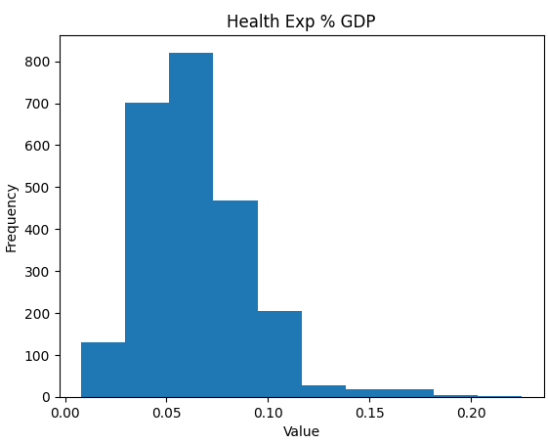
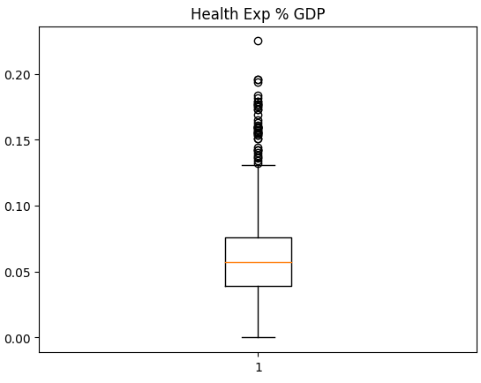
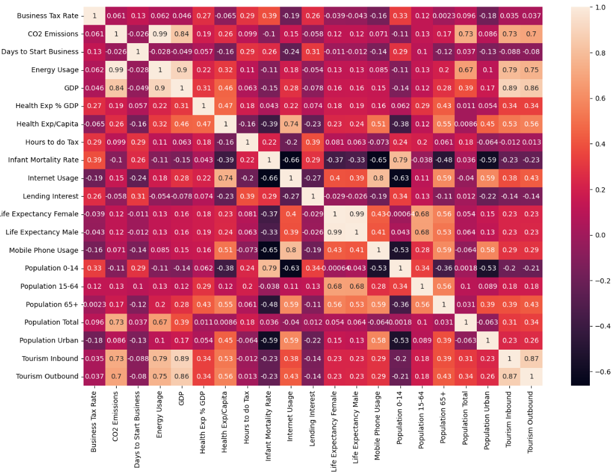
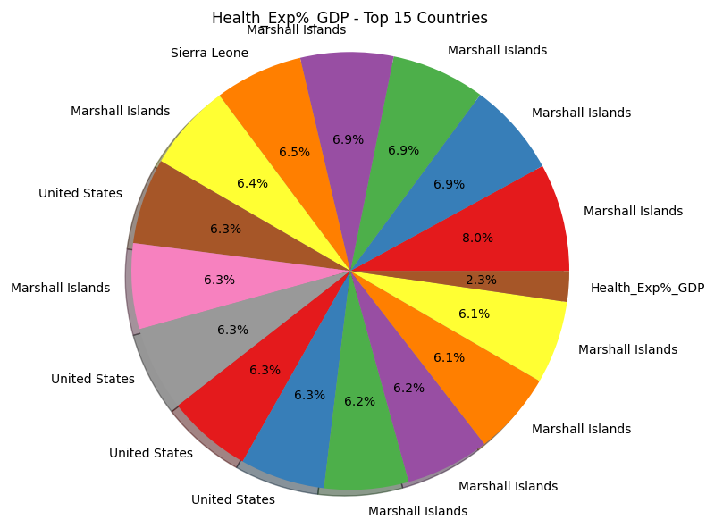
EDA
Histogram, Whiskers plot, Heat Map & Pie Chart

Slide 8
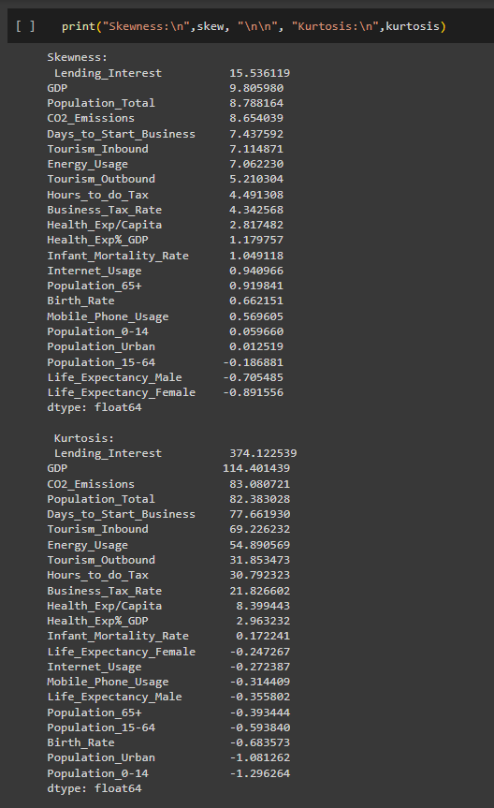
SKEWNESS
KURTOSIS

Slide 9
Feature Engineering
Feature Engineering is the process of selecting, manipulating, and transforming raw data into features that can be used in supervised learning.
Goal of simplifying and speeding up data transformations while also enhancing model accuracy.
Dropped Columns: “ Ease of Business” and “Number of Records”
Treatment on missing values was performed.
The Visualization of Data Distribution has been performed through a “Histogram”
Outlier Detection done using Box Plots
A Correlation was done between the variables and a Heat Map has been generated to show the highest correlation between each variable.

Slide 10
Model Building
Hierarchical or Agglomerative Clustering
Performed Agglomerative Clustering
Plotted Dendrogram
Found 4 clusters using ‘complete linkage method’
K-Means Clustering
K-Means clustering method is used to find out exact possible number of clusters present in the dataset.
Using Elbow curve we discovered there are 4 major clusters present in the dataset.

Slide 11
Pair Plots

Slide 12
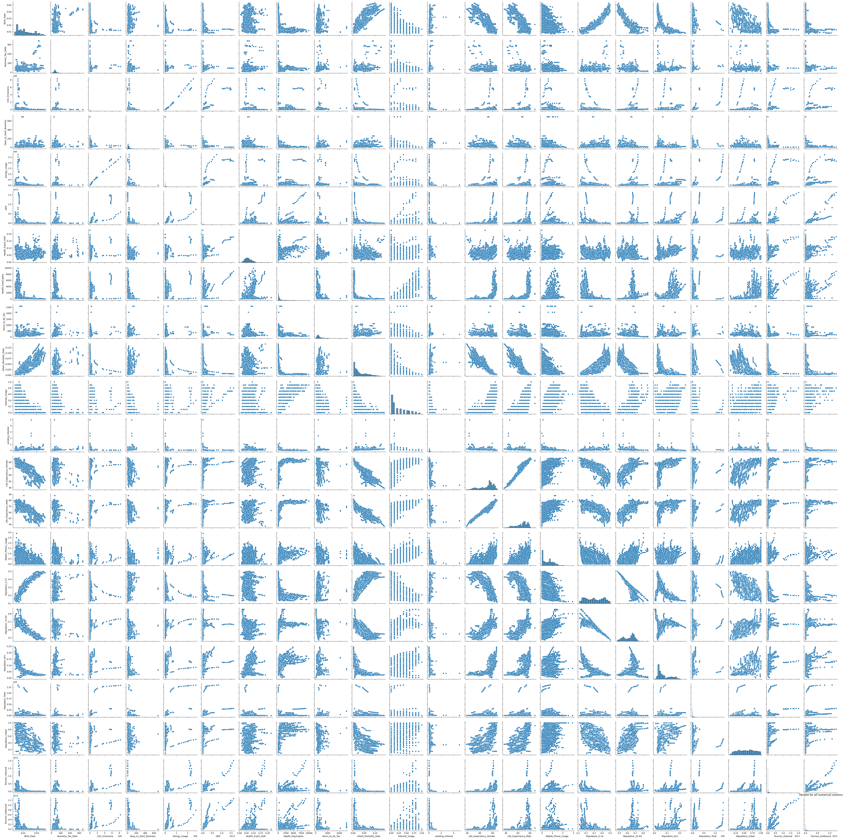

Slide 13
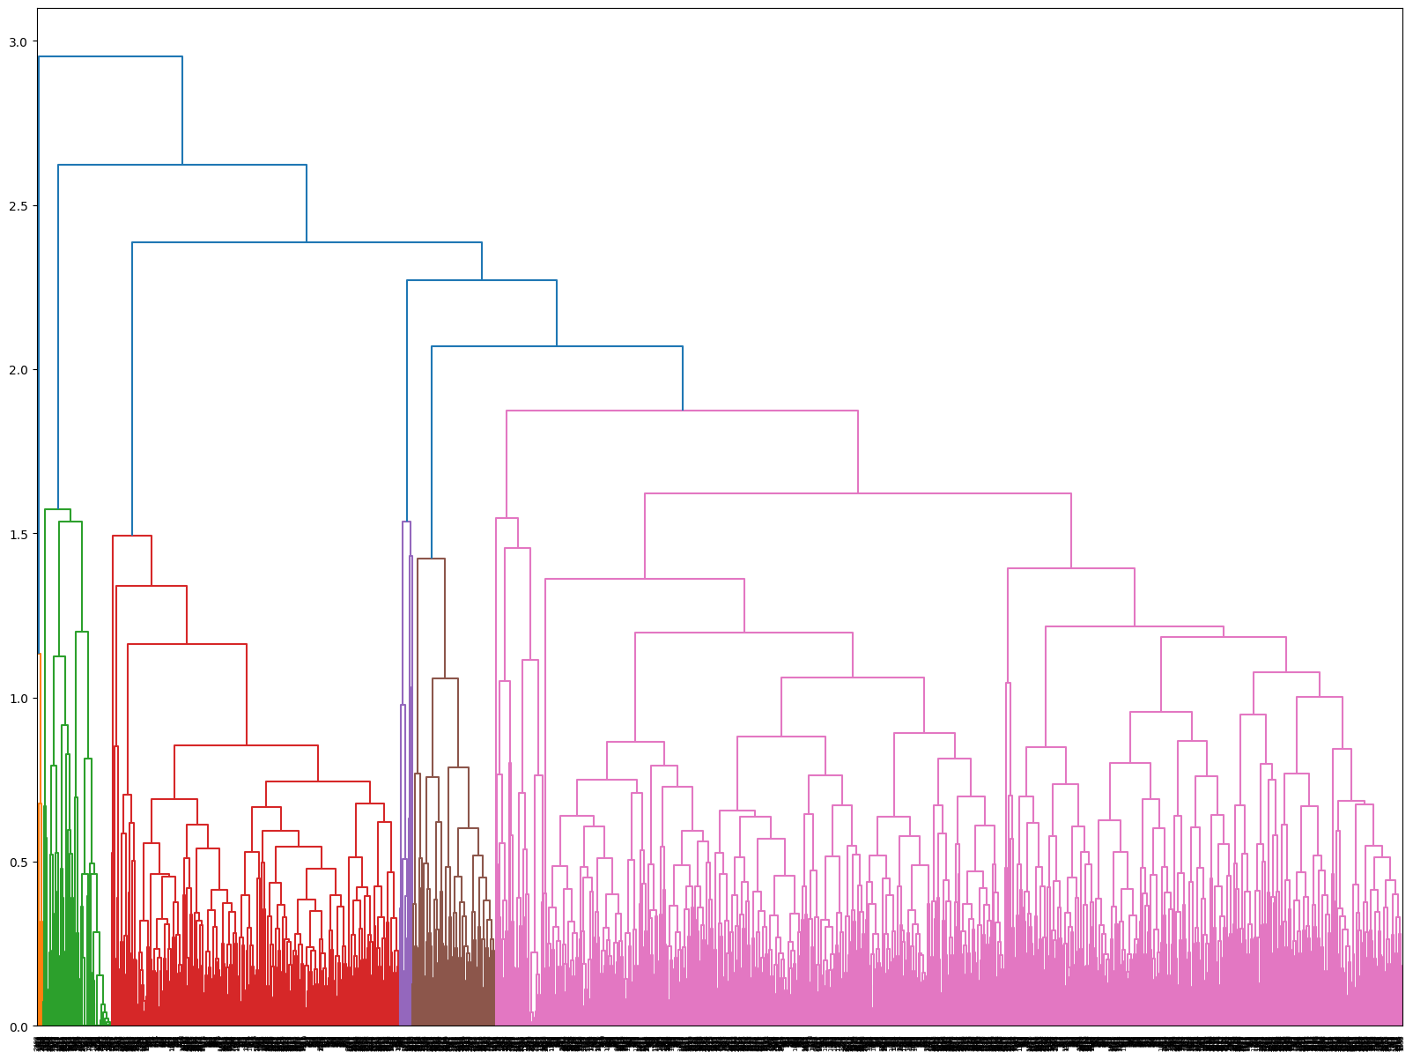
Dendrogram

Slide 14
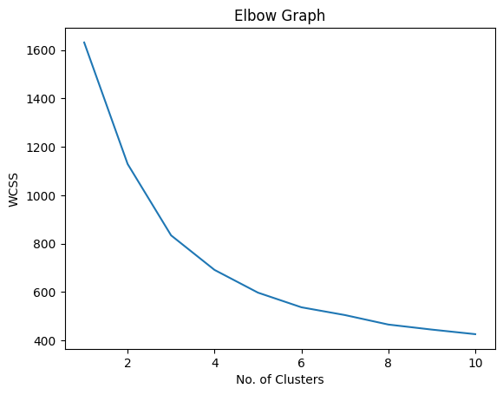
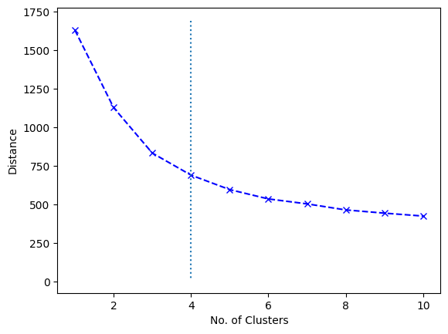
By using dendrogram we are able to see relationships between clusters. We get aggregate information from bottom to top.
K-means clustering is a popular unsupervised learning algorithm used for partitioning data into clusters. It aims to group similar data points together based on their feature similarity.

Slide 15
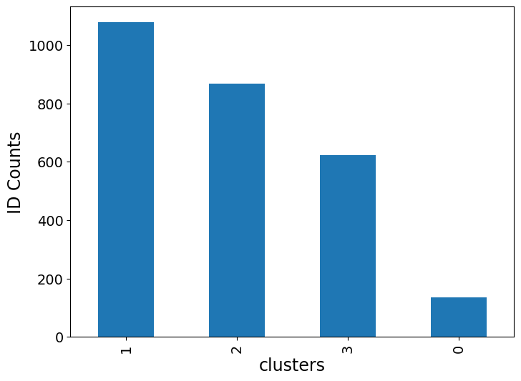
Model Validation
Two methods were used for Model Validation:
1. Silhouette Coefficient
2. Calinski Harabasz Score
Among these 2 models it was observed that K-Means Clustering is the best model to deploy.
From above Elbow graph it is observed that optimal number of clusters are 4

Slide 16
Model Deployment
Using Streamlit Library
Tools/Platforms used – Spyder

Slide 17
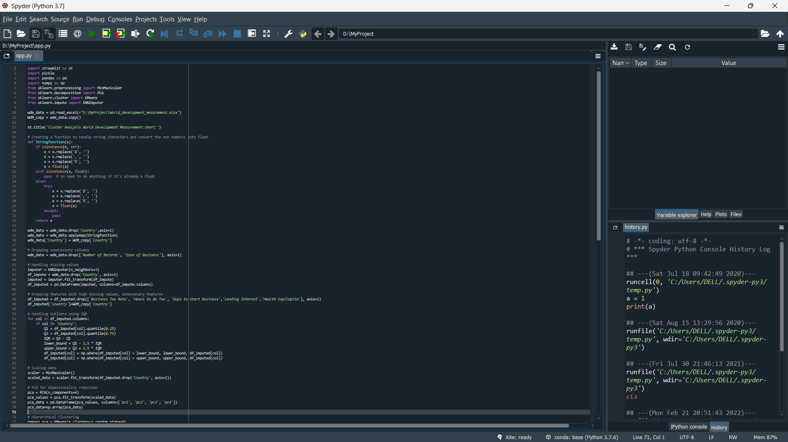

Slide 18
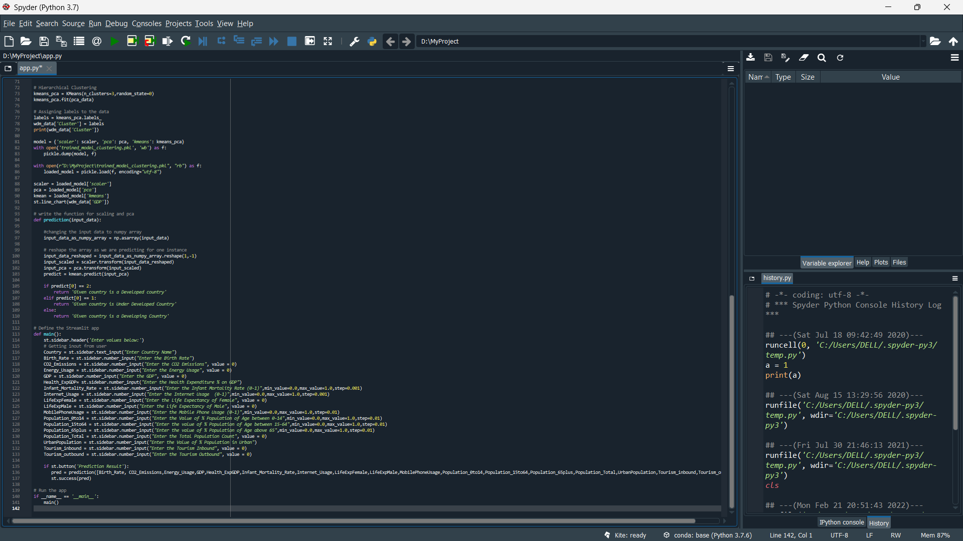

Slide 19
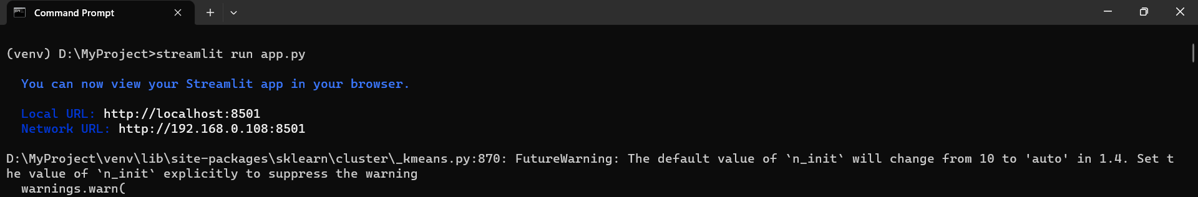
Running app using Streamlit

Slide 20
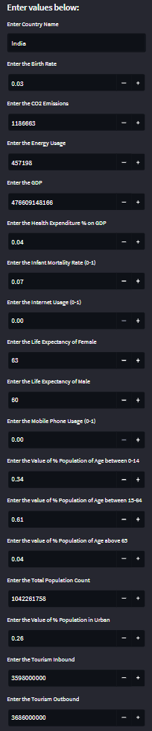
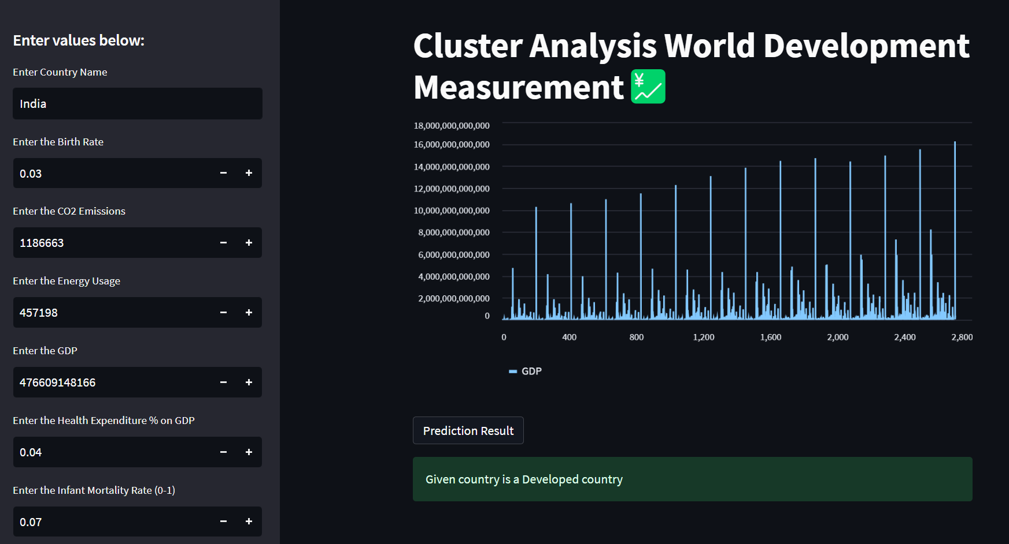

Slide 21
Challenges faced?
While plotting the visuals
The deployment part of the project was quite difficult while creating the app and executing it.
How did you overcome?
By consulting the mentor
Using various types of platforms

Slide 22
Thank you

